Slide 1
Day 12
Path Generation

Slide 2
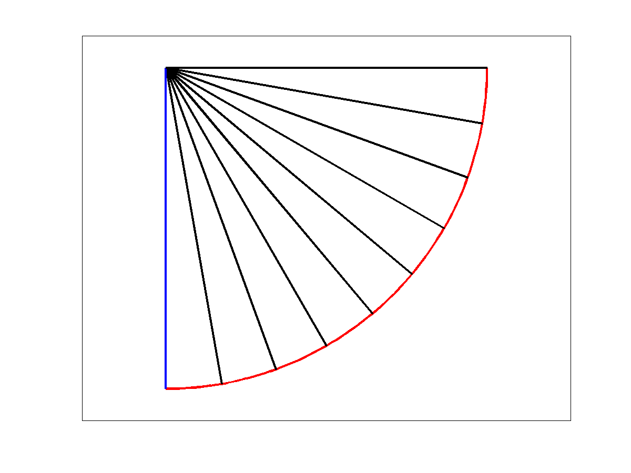
Joint-Space Path
a joint-space path is computed considering the joint variables
link 2
link 1
end effector path

Slide 3
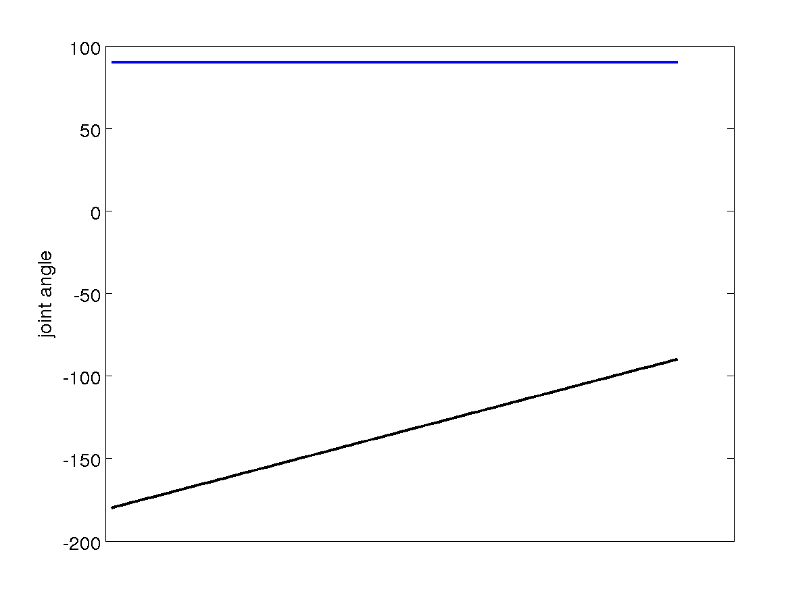
Joint-Space Path Joint Angles
link 1
link 2

Slide 4
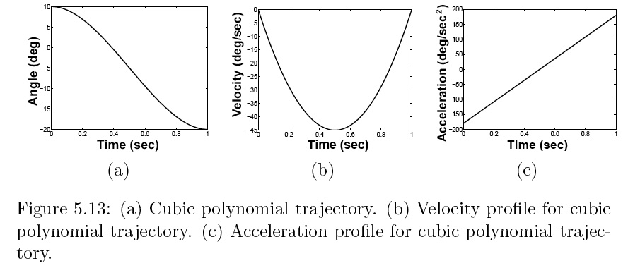
Cubic Polynomial Path

Slide 5
Quintic Polynomial Path

Slide 6
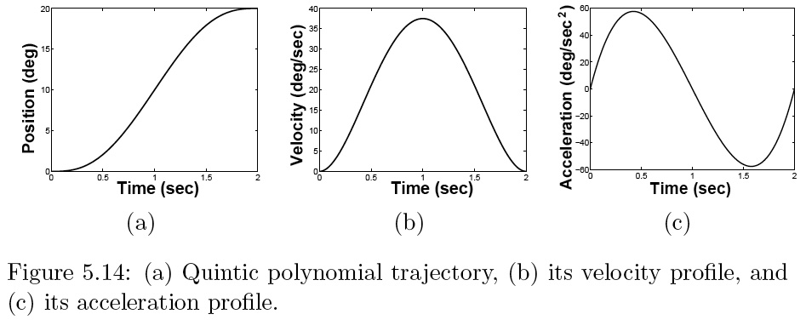
Quintic Polynomial Path

Slide 7
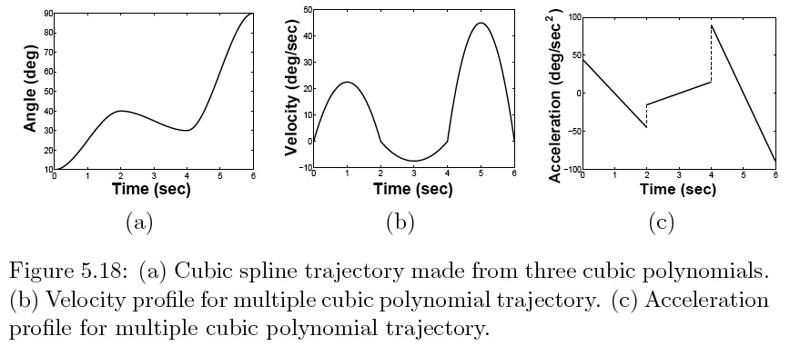
4 Via Points with Cubic Polynomials

Slide 8
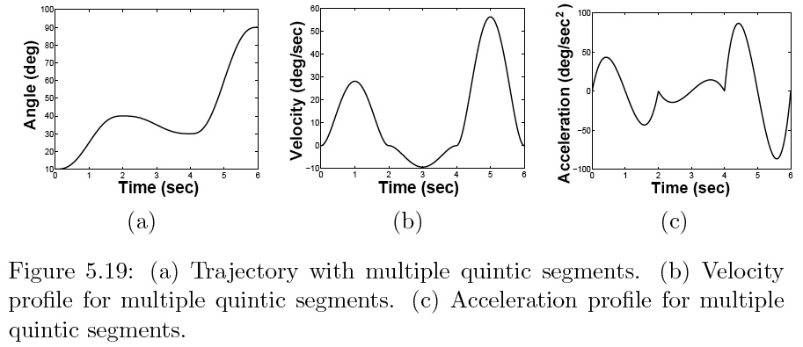
4 Via Points with Quintic Polynomials

